Slide 1
PROG6212 POE POWERPOINT ST10437073 HASHMIRA GOVENDER

Slide 2
AGENDA
Github Repo
HR Dashboard
Lecturer Dashboard
Coordinator Dashboard

Slide 3
https://github.com/GovenderHashmira/CMCS_POE
This is a new repo I created that is public to access my project.
Inside it is
- Youtube video (https://youtu.be/Y5z648RvBCg)
POE project files
POE Documentation
POE PowerPoint
DataScript.sql
SchemaScript.sql

Slide 4
HR Dashboard

Slide 5
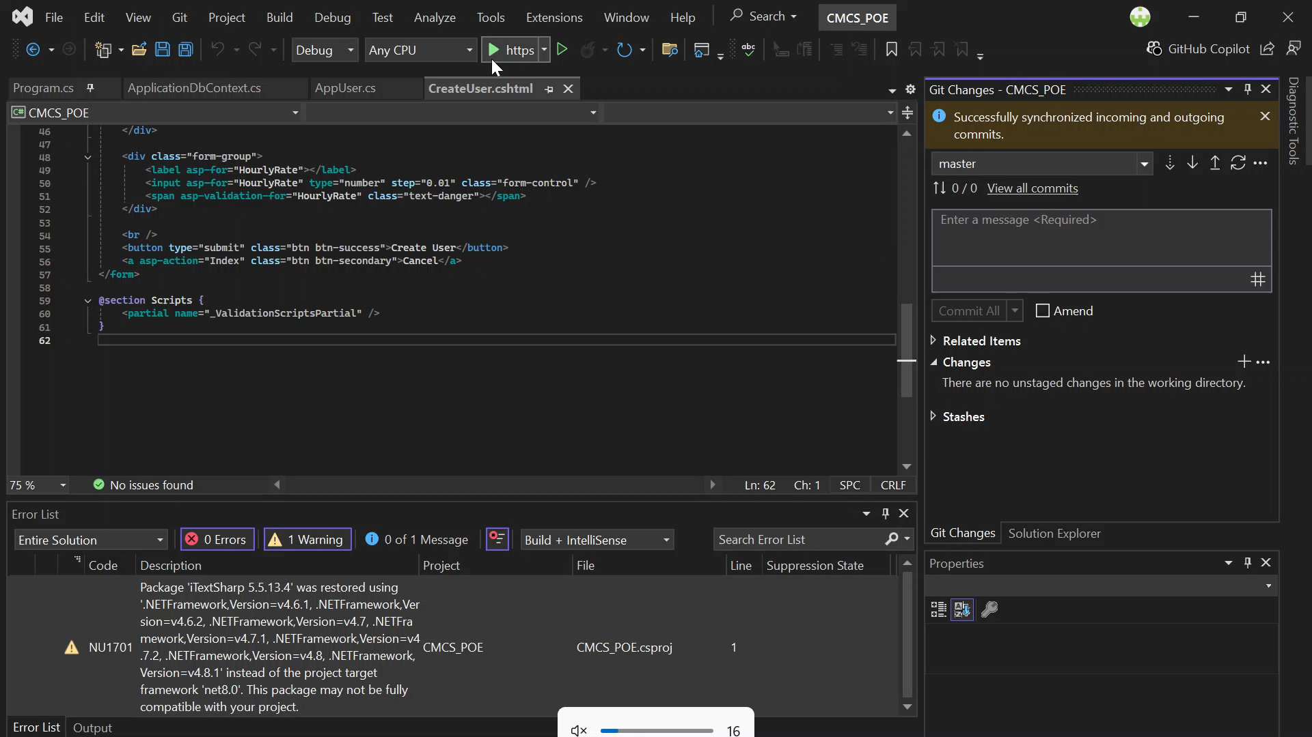
VIDEO

Slide 6
For HR, the system helps take a lot of the manual work out of managing lecturer claims. HR can easily update lecturer details, adjust hourly rates, and keep everyone’s information up to date without needing to dig through spreadsheets. The dashboard also gives HR a clear view of all approved claims, making it much easier to prepare for payments and double-check details. One of the biggest time-savers is the built-in PDF report generator, which pulls all approved claims into a clean downloadable report using LINQ. This means HR no longer has to create invoices or summaries by hand. Everything is built on ASP.NET Core MVC with Entity Framework and Identity, so the process is secure, organized, and much more efficient overall.

Slide 7
Lecturer Dashboard

Slide 8
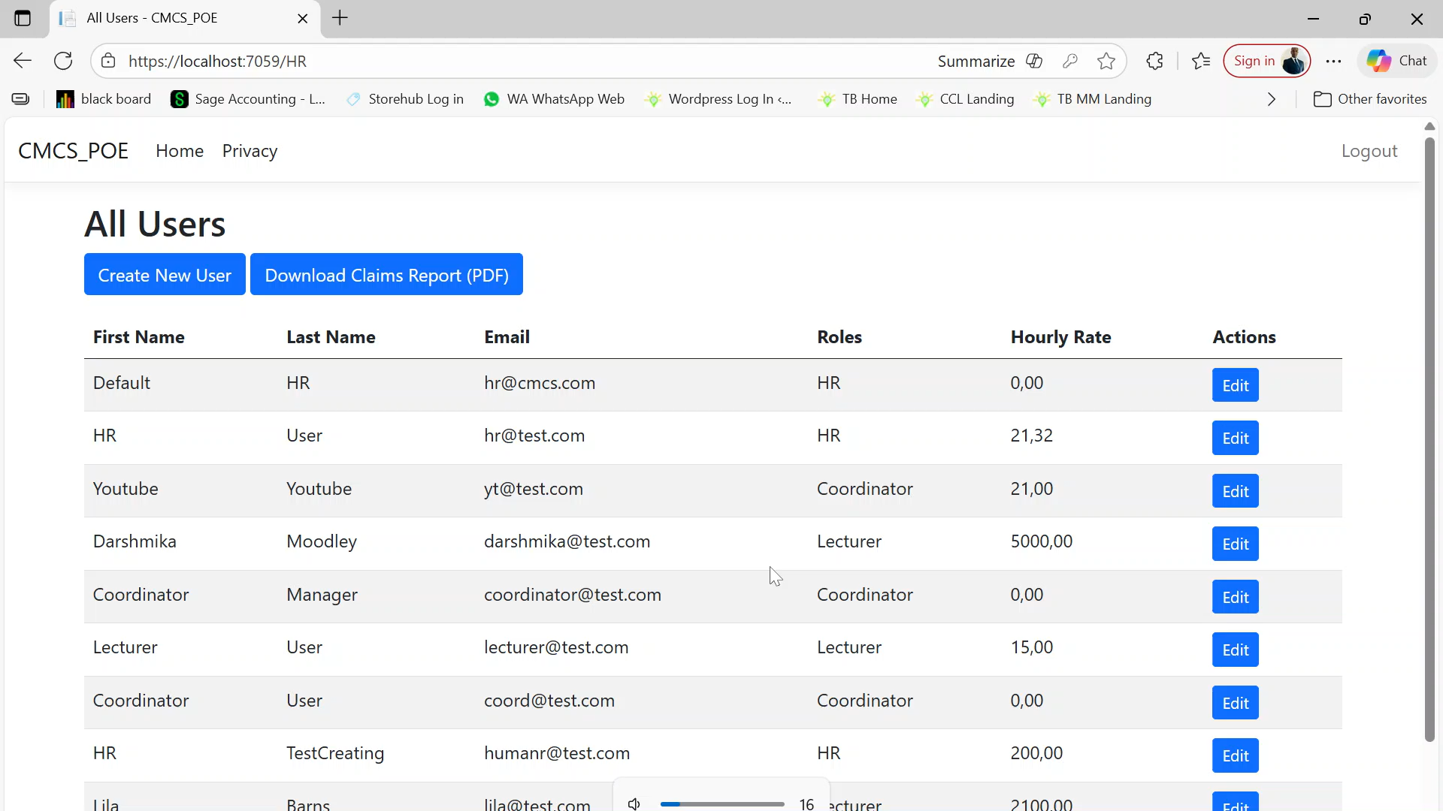
VIDEO

Slide 9
For lecturers, the process of submitting claims is quicker and easier. The GUI is simple and they no longer need to do manual calculations, the system will guide them through the process step by step. They simply enter the hours they worked and the system automatically works out the total amount based on their hourly rate that HR saved to their user. It also includes built-in validation, so if something doesn’t look right—like missing details or unrealistic hours they'll get a prompt to fix it.
The app is structured and reliable. Simple client-side tools like jQuery help with real-time calculations and checks, so they don’t have to wait. And Entity Framework takes care of storing and retrieving their claim information. The whole idea is to make the claim submission process smooth, accurate, and easy to use.

Slide 10
coordinator Dashboard

Slide 11
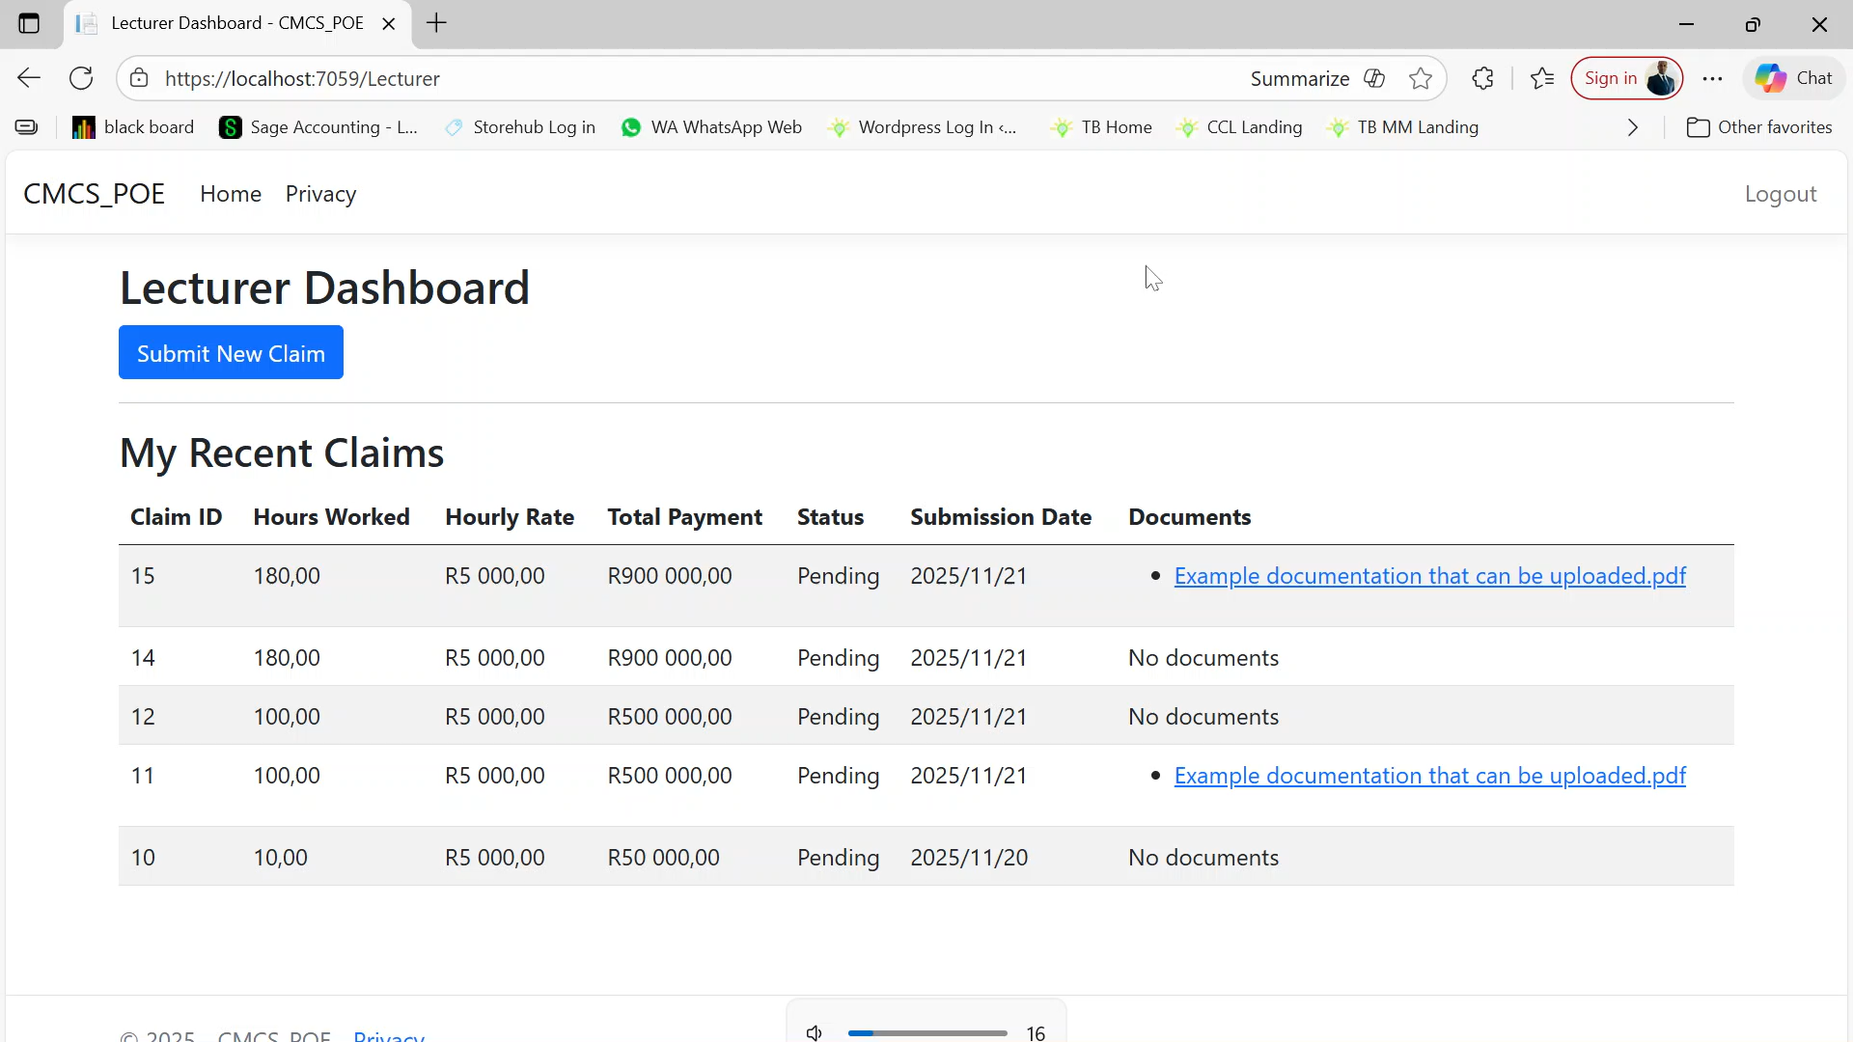
VIDEO

Slide 12
As the Coordinator and Academic Manager, their main job is to make sure that claims submitted by staff are checked quickly and accurately. Instead of manually going through each claim, the system can take over a lot of that heavy lifting. For example, it can automatically check whether the hours worked make sense, if the hourly rate matches the policy, and if all required fields were filled in correctly. This saves them time and helps avoid simple human errors.
Once a claim passes these checks, the system can guide it through an approval workflow, so they can review, approve, or send it back for corrections with just a few clicks. On the technical side, ASP.NET Identity keeps everything secure by managing logins and permissions, while Entity Framework lets the system easily read and update data behind the scenes. Tools like FluentValidation or Windows Workflow Foundation help define the rules and approval steps so the whole process feels smooth and consistent for everyone using it.

Slide 13
THANK YOU
ST10437073 HASHMIRA GOVENDER

